Slide 1
DATA 300 Statistical Machine Learning
Linear regression: interpretation and extensions

Slide 2
Agenda
Basic coefficient interpretation
Extensions
Interpreting categorical variables
Interaction between predictors
Nonlinearity between a predictor and the response

Slide 3


Interpreting the following model:
Sales is the sales revenue, TV/radio/newspaper is the advertising expenses in TV/radio/newspaper respectively.
How do you interpret $β_{0}$ ?
How do you interpret $β_{j}, j=1, 2, 3 ?$

Slide 4
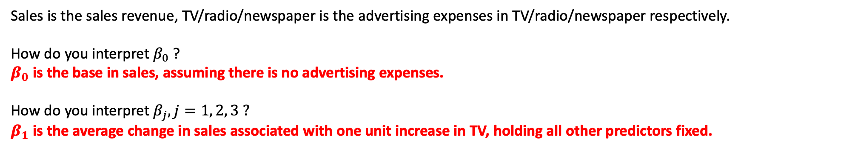
Interpreting the following model:
Sales is the sales revenue, TV/radio/newspaper is the advertising expenses in TV/radio/newspaper respectively.
How do you interpret $β_{0}$ ?
$β_{0}$ is the base in sales, assuming there is no advertising expenses.
How do you interpret $β_{j}, j=1, 2, 3 ?$
$β_{1}$ is the average change in sales associated with one unit increase in TV, holding all other predictors fixed.

Slide 5
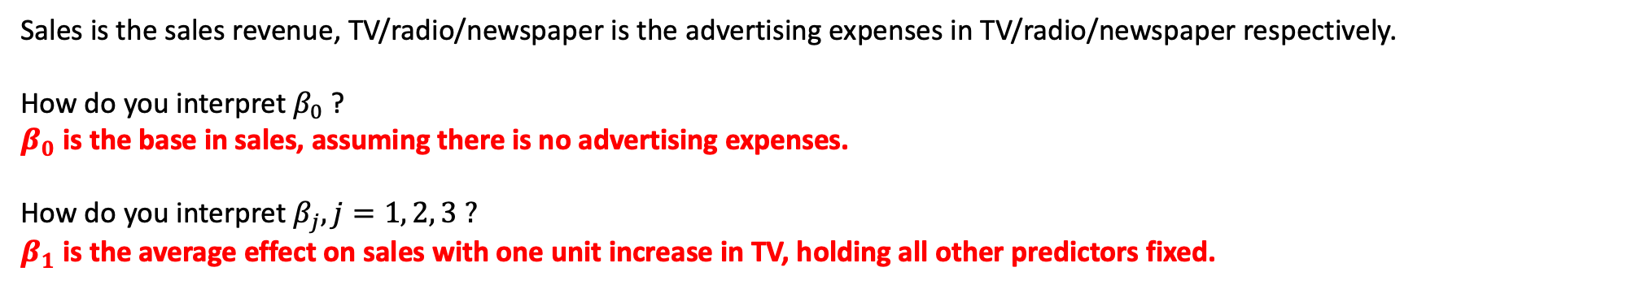
Interpreting the following model:
Sales is the sales revenue, TV/radio/newspaper is the advertising expenses in TV/radio/newspaper respectively.
How do you interpret $β_{0}$ ?
$β_{0}$ is the base in sales, assuming there is no advertising expenses.
How do you interpret $β_{j}, j=1, 2, 3 ?$
$β_{1}$ is the average effect on sales with one unit increase in TV, holding all other predictors fixed.
What happens to the interpretation of $β_{j}, j=1, 2, 3$, if the predictors are correlated with each other?

Slide 6
Interpreting the following model:
Sales is the sales revenue, TV/radio/newspaper is the advertising expenses in TV/radio/newspaper respectively.
How do you interpret $β_{0}$ ?
$β_{0}$ is the base in sales, assuming there is no advertising expenses.
How do you interpret $β_{j}, j=1, 2, 3 ?$
$β_{1}$ is the average effect on sales with one unit increase in TV, holding all other predictors fixed.
What happens to the interpretation of $β_{1}$, if the predictors are correlated with each other?
If TV expenses increases are correlating with changes in other expenses, then the interpretation becomes hazardous since now we can no longer hold other predictors fixed.

Slide 7
Assumptions on predictors
Ideally, in linear regression the predictors should be uncorrelated with each other. This is because:
Mathematically, it enables us to estimate each coefficient separately.
Conceptually, this enables us to interpret each of the coefficients.

Slide 8

Interpreting coefficients for categorical variables
$$GPA= b_{0}+b_{1}∗gender$$
Gender = 1 means a student is female, and gender = 0 means a student is male. How to interpret the intercept and the coefficients?

Slide 9
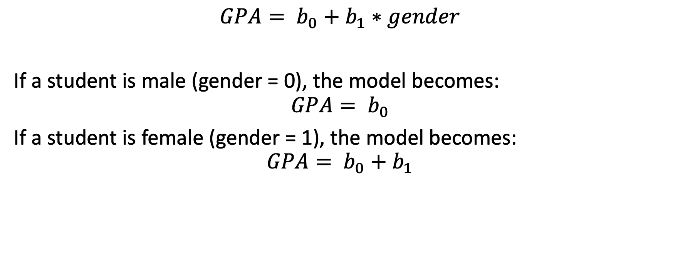
Interpreting coefficients for categorical variables
$$GPA= b_{0}+b_{1}∗gender$$
If a student is male (gender = 0), the model becomes:
$$GPA= b_{0}$$
If a student is female (gender = 1), the model becomes:
$$GPA= b_{0}+b_{1}$$

Slide 10
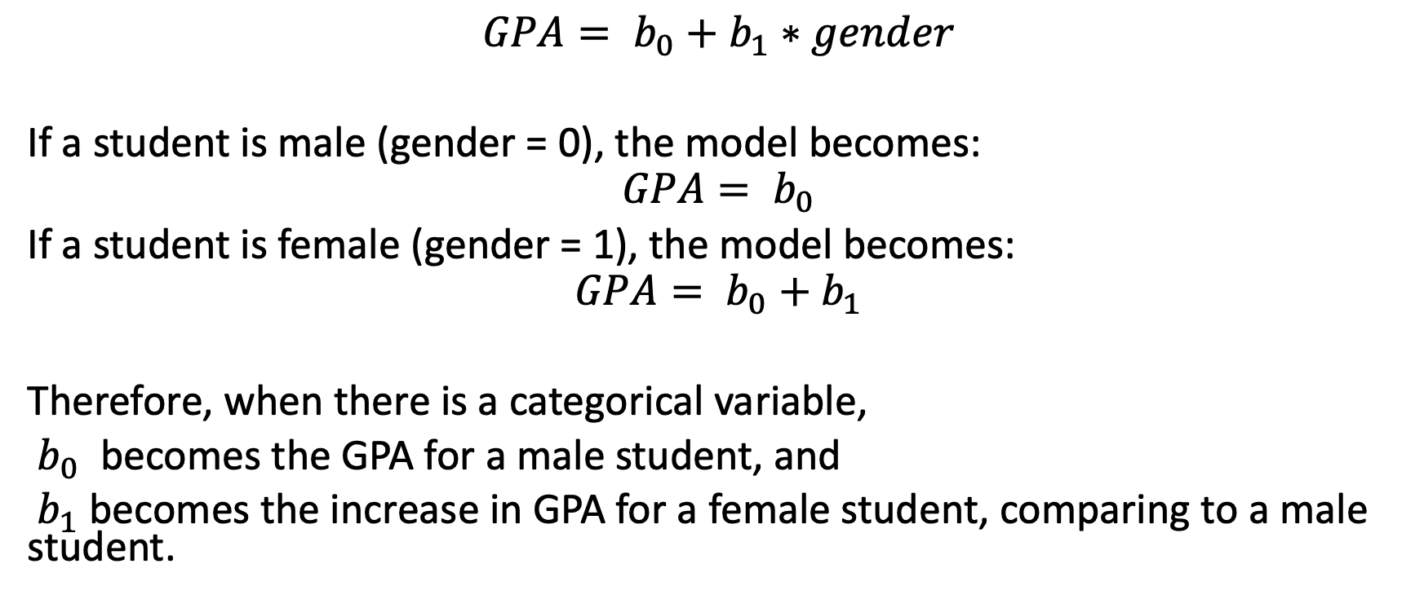
Interpreting coefficients for categorical variables
$$GPA= b_{0}+b_{1}∗gender$$
If a student is male (gender = 0), the model becomes:
$$GPA= b_{0}$$
If a student is female (gender = 1), the model becomes:
$$GPA= b_{0}+b_{1}$$
Therefore, when there is a categorical variable,
$b_{0}$ becomes the GPA for a male student, and
$b_{1}$ becomes the increase in GPA for a female student, comparing to a male student.

Slide 11

Practice: Interpreting coefficients for categorical variables
$$GPA= b_{0}+b_{1}∗sophomore+b_{2}∗junior+b_{3}∗senior$$
Sophomore, junior, and senior are all binary variables. Interpret $b_{0}$, $b_{1}$, $b_{2}, b_{3}$.

Slide 12
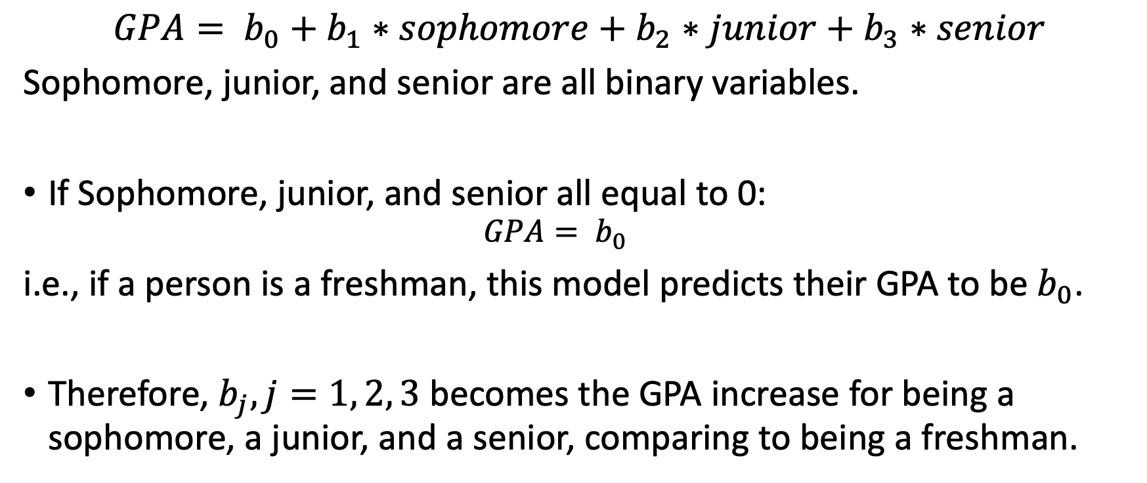
Practice: Interpreting coefficients for categorical variables
$$GPA= b_{0}+b_{1}∗sophomore+b_{2}∗junior+b_{3}∗senior$$
Sophomore, junior, and senior are all binary variables.
If Sophomore, junior, and senior all equal to 0:
$$GPA= b_{0}$$
i.e., if a person is a freshman, this model predicts their GPA to be $b_{0}$.
Therefore, $b_{j}, j=1, 2, 3$ becomes the GPA increase for being a sophomore, a junior, and a senior, comparing to being a freshman.

Slide 13
Practice: Interpreting coefficients for categorical variables
$$GPA= b_{0}+b_{1}∗sophomore+b_{2}∗junior+b_{3}∗senior$$
Sophomore, junior, and senior are all binary variables.
If Sophomore, junior, and senior all equal to 0:
$$GPA= b_{0}$$
i.e., if a person is a freshman, this model predicts their GPA to be $b_{0}$.
Therefore, $b_{j}, j=1, 2, 3$ becomes the GPA increase for being a sophomore, a junior, and a senior, comparing to being a freshman.
All categorical variables equal to 0 makes this a baseline.

Slide 14
Agenda
Extensions
Interpreting categorical variables
Interaction between predictors
Nonlinearity between a predictor and the response

Slide 15
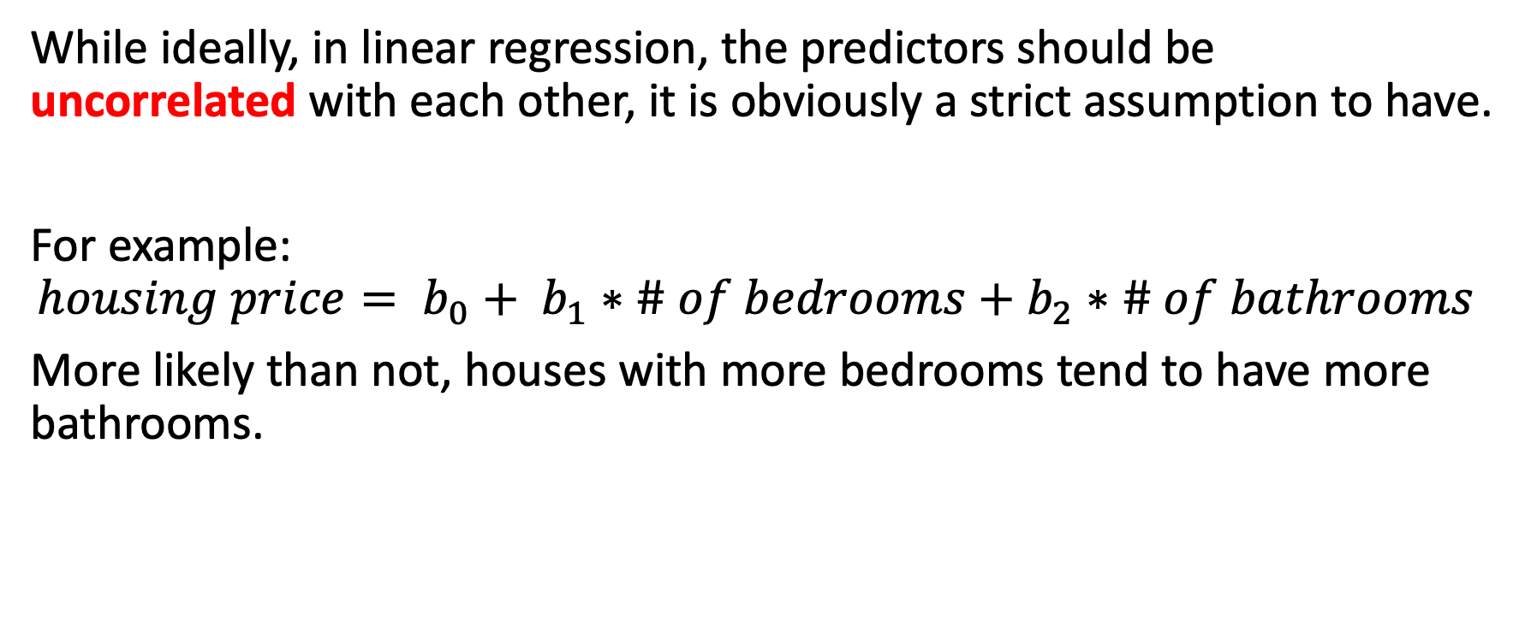
Interaction between predictors
While ideally, in linear regression, the predictors should be uncorrelated with each other, it is obviously a strict assumption to have.
For example:
$$housing price= b_{0}+ b_{1}∗\# of bedrooms+b_{2}∗\# of bathrooms$$
More likely than not, houses with more bedrooms tend to have more bathrooms.

Slide 16
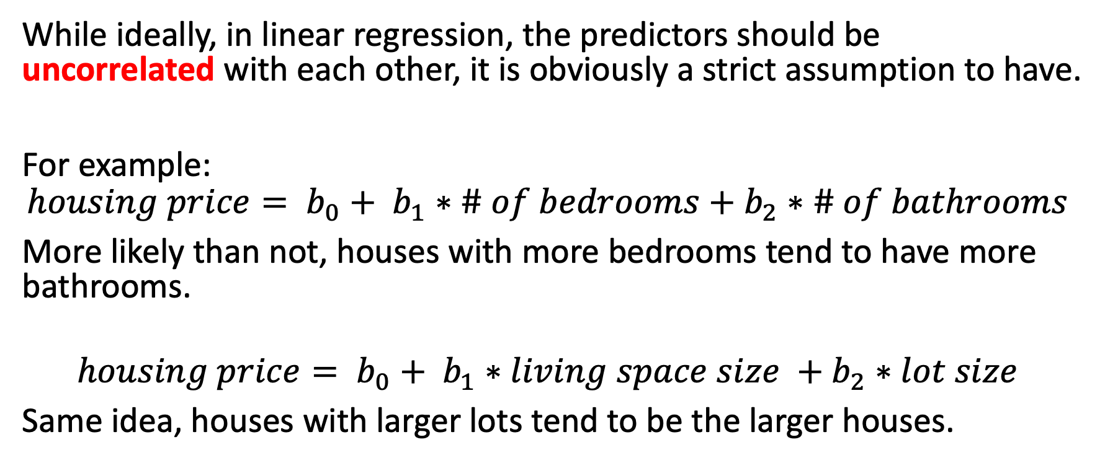
Interaction between predictors
While ideally, in linear regression, the predictors should be uncorrelated with each other, it is obviously a strict assumption to have.
For example:
$$housing price= b_{0}+ b_{1}∗\# of bedrooms+b_{2}∗\# of bathrooms$$
More likely than not, houses with more bedrooms tend to have more bathrooms.
$$housing price= b_{0}+ b_{1}∗living space size +b_{2}∗lot size$$
Same idea, houses with larger lots tend to be the larger houses.

Slide 17
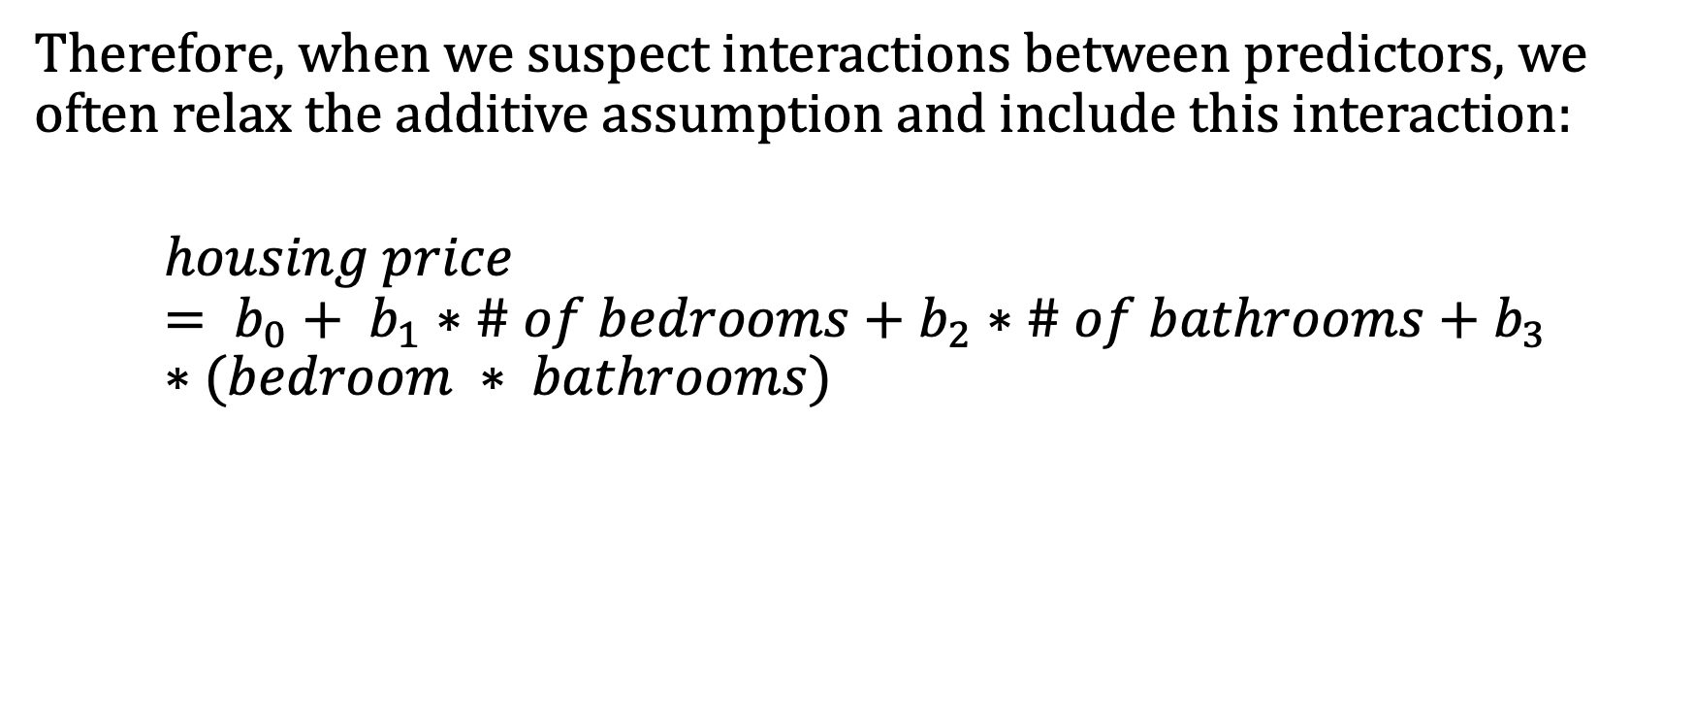
Interaction between predictors
Therefore, when we suspect interactions between predictors, we often relax the additive assumption and include this interaction:
$$housing price= b_{0}+ b_{1}∗\# of bedrooms+b_{2}∗\# of bathrooms+b_{3}∗(bedroom ∗ bathrooms)$$

Slide 18
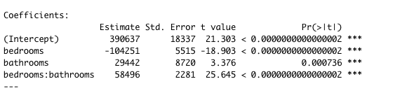
Interaction between predictors
Therefore, when we suspect interactions between predictors, we often relax the additive assumption and include this interaction:
$$housing price= b_{0}+ b_{1}∗\# of bedrooms+b_{2}∗\# of bathrooms+b_{3}∗(bedroom ∗ bathrooms)$$

Slide 19
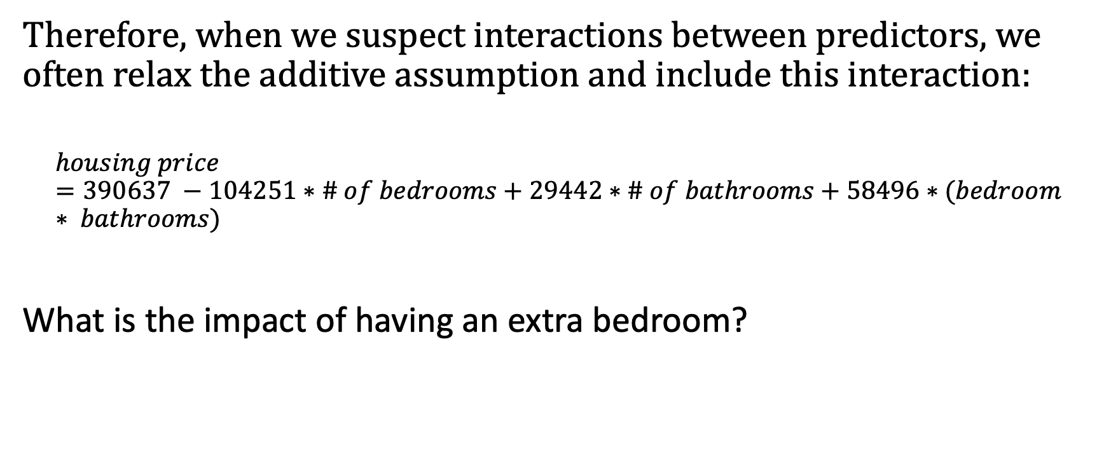
Interaction between predictors
Therefore, when we suspect interactions between predictors, we often relax the additive assumption and include this interaction:
$$housing price=390637 −104251∗\# of bedrooms+29442∗\# of bathrooms+58496∗(bedroom ∗ bathrooms)$$
What is the impact of having an extra bedroom?

Slide 20
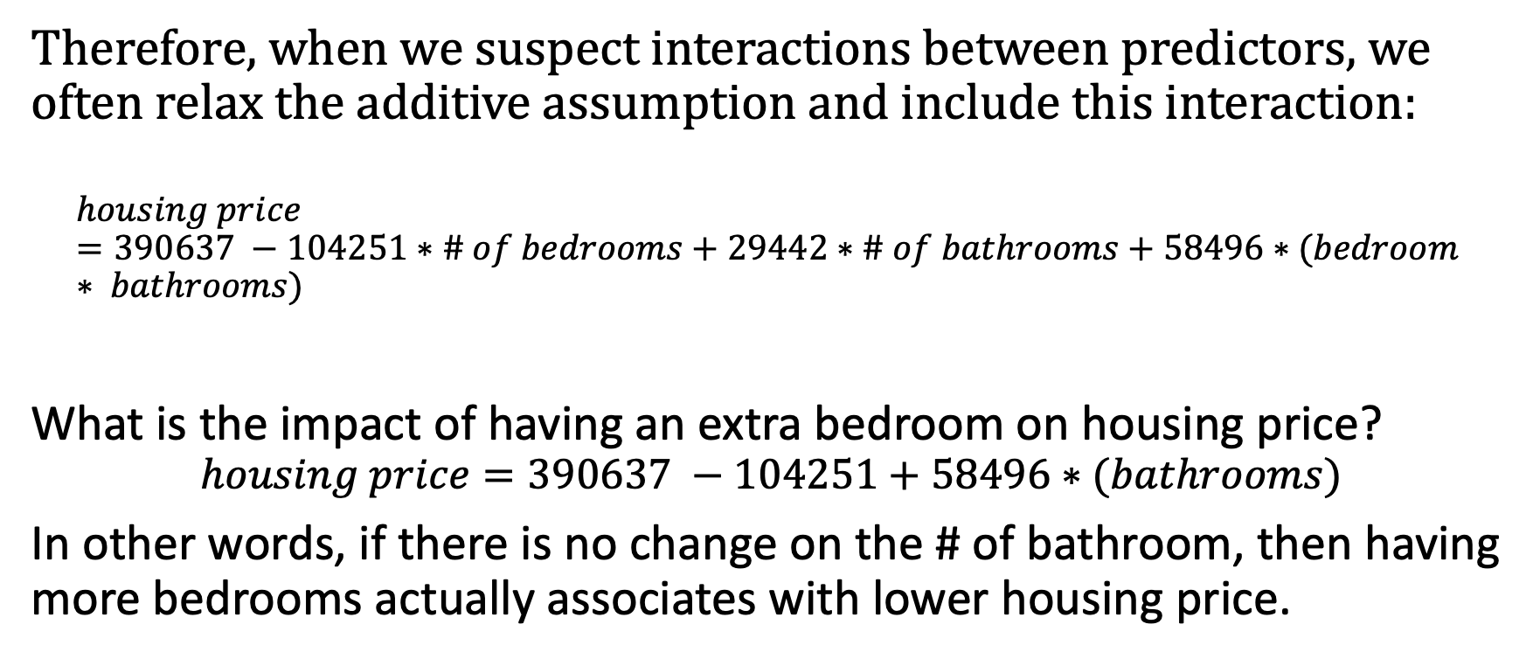
Interaction between predictors
Therefore, when we suspect interactions between predictors, we often relax the additive assumption and include this interaction:
$$housing price=390637 −104251∗\# of bedrooms+29442∗\# of bathrooms+58496∗(bedroom ∗ bathrooms)$$
What is the impact of having an extra bedroom on housing price?
$$housing price=390637 −104251+58496∗(bathrooms)$$
In other words, if there is no change on the # of bathroom, then having more bedrooms actually associates with lower housing price.

Slide 21
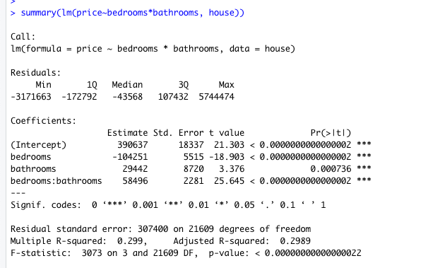

Implementing in R
If you want to include an interaction term:
Whenever you include an interaction term, it automatically includes the two original variables.

Slide 22
Do it on your own
Using the house dataset from homework 5. Only include # of bedrooms, waterfront, and their interaction as the predictors. Explain the coefficients.

Slide 23
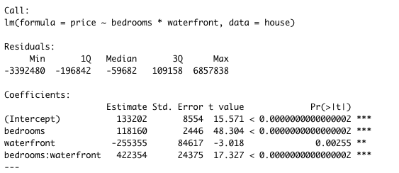
Coefficients for categorical interaction
$$housing price=133202+118160∗\# of bedrooms−255355∗waterfront+422354∗(bedroom ∗waterfront)$$

Slide 24
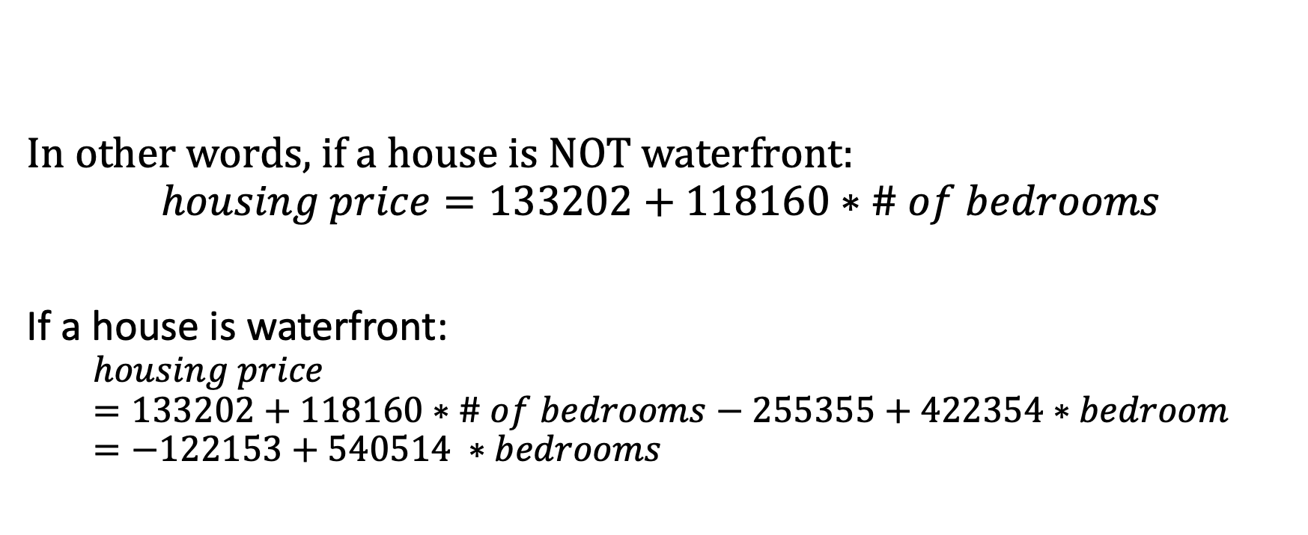
Coefficients for categorical interaction
$$housing price=133202+118160∗\# of bedrooms−255355∗waterfront+422354∗(bedroom ∗waterfront)$$
In other words, if a house is NOT waterfront:
$$housing price=133202+118160∗\# of bedrooms$$
If a house is waterfront:
$$housing price=133202+118160∗\# of bedrooms−255355+422354∗bedroom=−122153+540514 ∗bedrooms$$

Slide 25
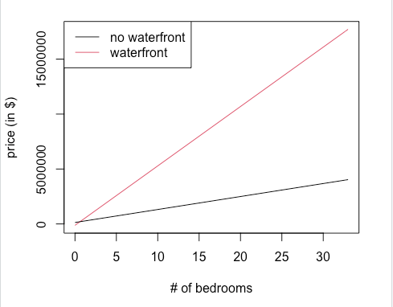
Coefficients for categorical interaction
$$housing price=133202+118160∗\# of bedrooms−255355∗waterfront+422354∗(bedroom ∗waterfront)$$

Slide 26
Benefits of having interaction terms
Most of the time, if you do suspect there is an interaction between predictors, including such an interaction could help boost goodness-of-fit.

Slide 27
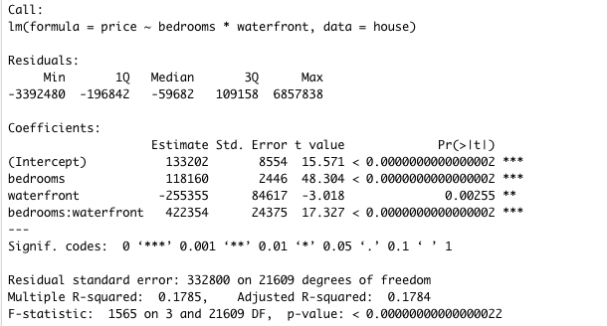
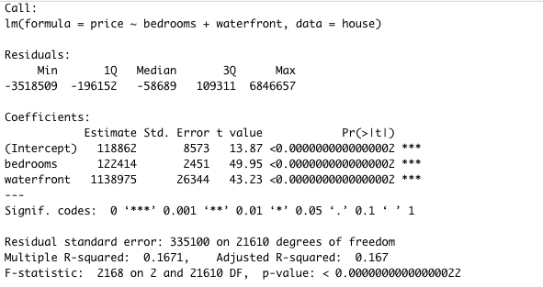
Benefits of having interaction terms
Most of the time, if you do suspect there is an interaction between predictors, including such an interaction could help boost goodness-of-fit.

Slide 28
Benefits of having interaction terms
Most of the time, if you do suspect there is an interaction between predictors, including such an interaction could help boost goodness-of-fit.
For example, including the interaction term increase the R-squared increased, i.e., including the interaction term helped explain the variability in housing price.

Slide 29
Agenda
Extensions
Interpreting categorical variables
Interaction between predictors
Nonlinearity between a predictor and the response

Slide 30
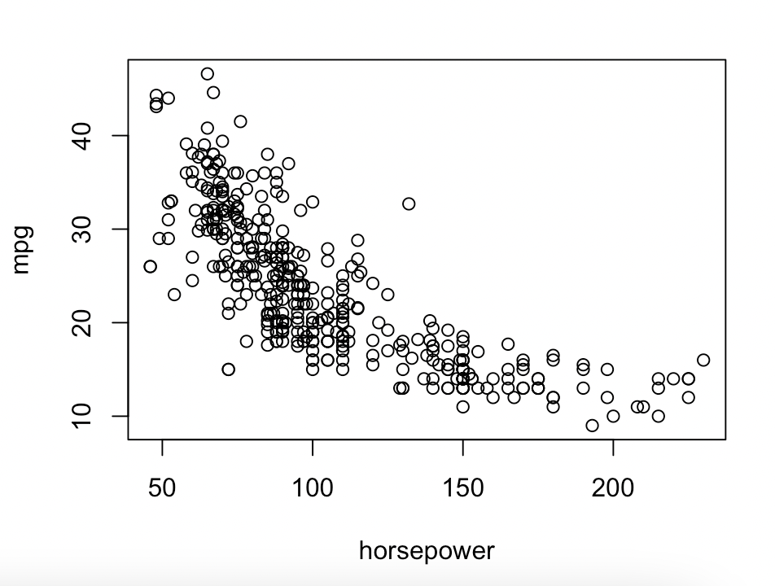
Non-linear effect of predictors
If we were to use horsepower to predict mpg for cars:
kind of linear? Kind of not?

Slide 31
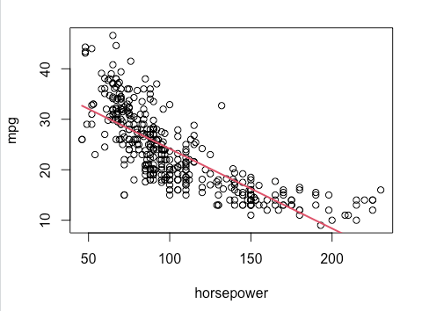


Fitting a linear model
$$mpg= b_{0}+b_{1}∗horsepower$$

Slide 32

Fitting a linear model
Think about the curve of a square function..

Slide 33

Including non-linear terms in linear regression
An immediate alternative is to include a square term:
$$mpg= b_{0}+b_{1}∗horsepower+b_{2}∗{horsepower}^{2}$$

Slide 34
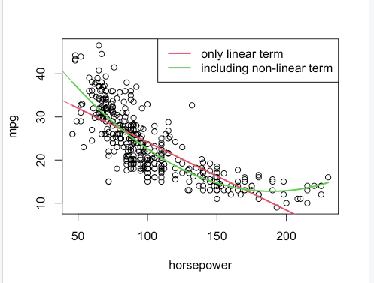
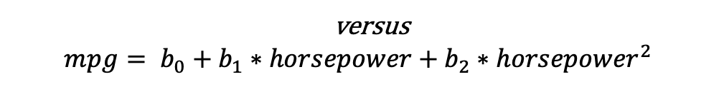
Including a nonlinear term in linear regression
$$mpg= b_{0}+b_{1}∗horsepower$$
versus
$$mpg= b_{0}+b_{1}∗horsepower+b_{2}∗{horsepower}^{2}$$

Slide 35
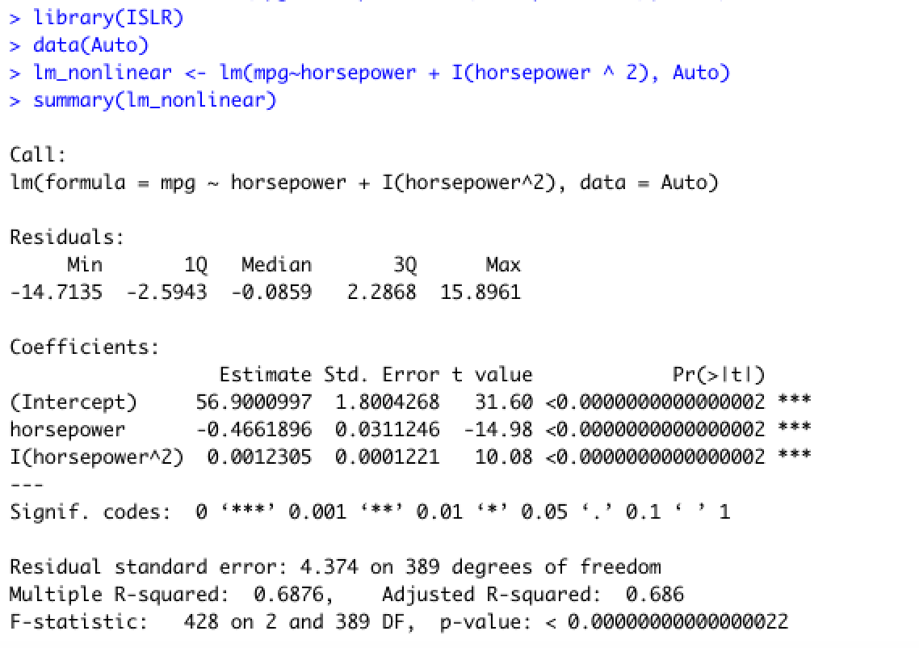
Implement in R
The I() function tells R this is a squared term

